Slide 1

Retry Pattern 🔁
by Enrico Pezzano

Slide 2

Introduction 🎬
“Resilient approach”
Robustness & tolerance is a paramount
Powerful & widely adopted
Systematic & flexible
⚡️
Reliability & availability
Notes:
Often referred to as “a resilient approach to fault tolerance” in SW design …
In the dynamic landscape of software development, ensuring robustness and fault tolerance is a paramount (// primordiale, cruciale, fondamentale).
One powerful and widely adopted strategy for handling transient failures and intermittent issues is the “retry pattern”.
It provides a systematic and flexible approach to deal with unpredictable events, contributing to the reliability and availability of SW systems.

Slide 3

Outlook 🫣
Why do we need it ?
What is it ?
What is the problem?
Pros & Cons ?
Solutions …
Code examples
Notes:
(It’s a fail-safe)
(Standard solutions to standard problems)
(Transient ones…)

Slide 4
“Each pattern describes a problem which occurs over and over again in our environment, and then describes the core of the solution to that problem, in such a way that you can use this solution a million times over, without ever doing it the same way twice.”
–Christopher Alexander, A Pattern Language 📖

Slide 5
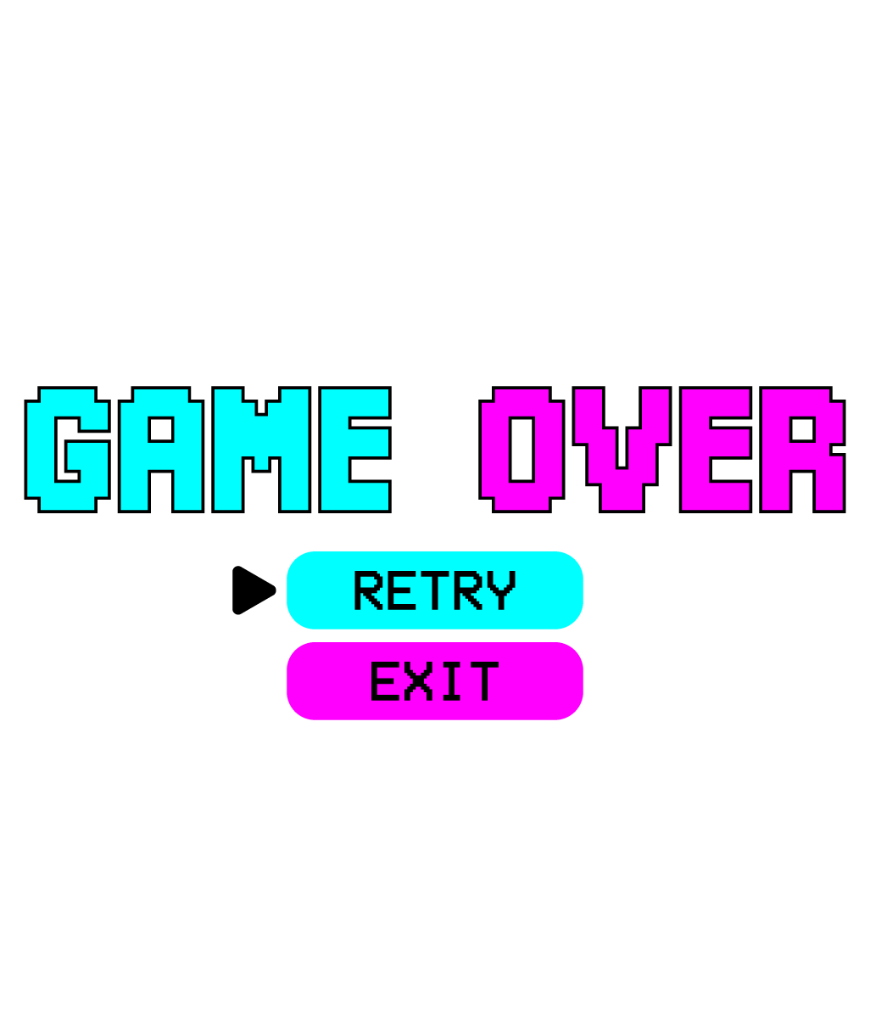
What is it❓🤨
⚡️ Specific strategy
⏰ Issues, external dependencies, etc
📲 Retry logic incorporated into the app
❤️‍🩹 Enhance system recovery from failures
🐆 Without jeopardising functionality
Notes:
The retry pattern is a design strategy that involves making multiple attempts to execute a piece of code or a specific operation in the face of transient failures.
They may be caused by temporary network issues, external dependencies or other unforeseen circumstances.
By incoRPorating retry logic into the application, developers aim to enhance the system’s ability to recover gracefully from such failures without compromising its overall functionality.

Slide 6
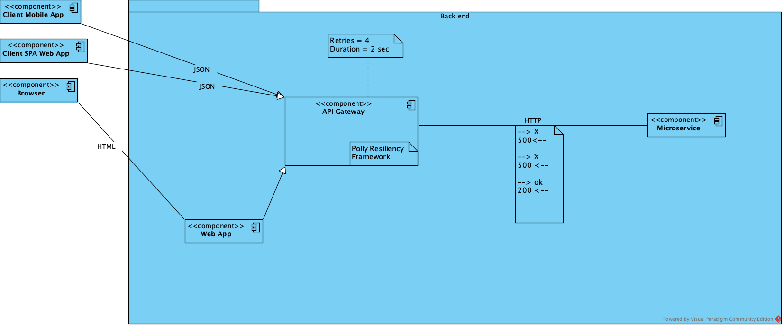
A design pattern for μ-services 🦠
Common pattern used also in a lot of others environments (e.g. …)
# of times it should retry, delay between attempts and actions to take
Typically self-correcting → if repeated, it’s likely to success 🔑💡
Keep in mind that an application should be designed to handle these types of situations elegantly and transparently
Notes:
RP is a common pattern for recovering from transient errors (Distributed Systems/environments, Database Operations, Cloud Computing, API Calls, File I/O and Storage Systems, Messaging Systems, Queue Processing, Long-Running Operations, Asynchronous Operations, Network Communications). It specifies the number of times it should retry, the delay between each attempt and the actions to take after a failed attempt.
(Transient error are those which last only for a short amount of time).
In a distributed environment, calls to remote resources and services can fail due to transient faults, such as slow network connections, timeouts or the resources themselves being overcommitted or temporarily unavailable.
These faults are typically self-correcting and if the action that triggered a fault is repeated after a suitable delay it’s likely to be successful. (This is the key idea behind the RP).
Eg (exempli gratia): a database service that’s processing a large number of concurrent requests can implement a throttling strategy that temporarily rejects any further requests until its workload has eased. So try again after a delay might lead to a successful run.

Slide 7
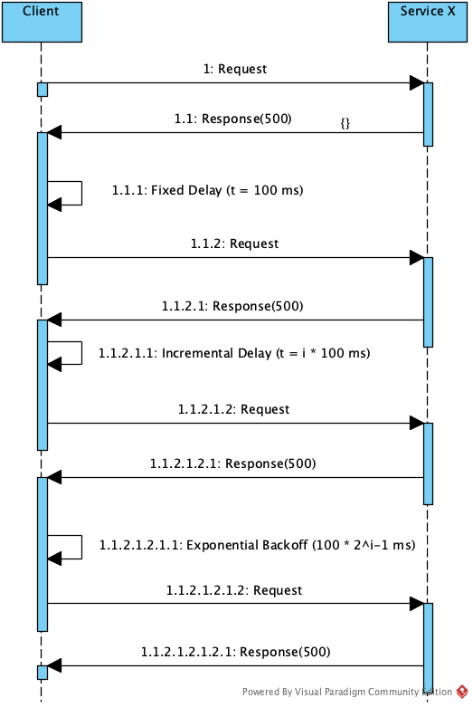
Strategies 🧠♟
Retry logic:
Retry
Retry after delay
Exponential backoff
Circuit breaker
Cancel
POV:
if overwhelming → longer to recover

Slide 8
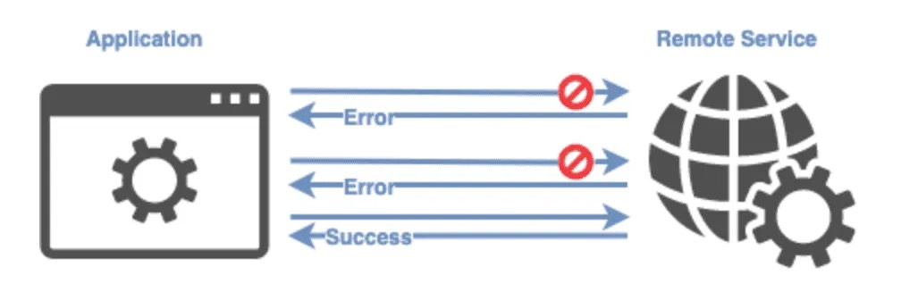
Issues and considerations 🤔
❌ Without a threshold, a bigger degrade is possible
❌ Responsiveness is at risk, if continually trying to perform a failing operation
⭕️ Sometimes it’s better to fail fast
✅ If exhausted resources → better solution to scale out
✅ If operation is idempotent, it’s safe to retry. Otherwise…
⭐️ Enhanced reliability & user experience
⭐️ Adaptability to dynamic environments
An idempotent system ensures that the actual execution on this request only happens once (doesn't matter the requests number)
Notes:
Retry policy with minimal delay between attempts and large number of retries (threshold) could further degrade a busy service that’s running close to maximal capacity and would take even more time to recover since it’s being bombarded with retry attempts.
This retry policy could also affect the responsiveness of the application itself if it’s continually trying to perform a failing operation. Hence, if a request still fails after a significant number of retries, it’s better for the application to prevent further requests going to the same service (resource) and simply report a failure immediately.
✅If a service is unavailable or busy most of the time, it’s usually because the service has exhausted its resources. So the better solution would be scaling out the service to reduce these faults.
Eg: if a db service is continually overloaded, it might be beneficial to partition the db and spread the load across multiple servers.
✅For some noncritical operations, it’s better to fail fast rather than retry several times and impact the throughput of the application.
Eg: in an interactive web application accessing a remote service, it’s better to fail after a small number of retries with only a short delay between retry attempts and display some suitable message to the user (“please try again later”).
✅If operation is idempotent it’s safe to retry. Otherwise, retries could cause the operation to be executed more than once, with unintended side effects.
Eg: making a payment. If a client makes a request to pay, the request is successful, but the client times out, the client could retry this same request. With an idempotent system, the person paying would not get charged twice. With a non-idempotent system, they could

Slide 9
“One shoe fits all” suitability? 👞🎯
✅ Transients faults
✅ Short lived and repeating a (failed) request
❌ Long lasting faults → retrying damage the responsiveness
❌ Non-transient faults …
❌ Busy faults frequently → better to scale out
…if all you have is a hammer, everything looks like a nail…
Failures due to various reasons and various natures
Some exceptions can be resolved quickly
Some are longer lasting
👉🏻Retry policy to adjust everything
Notes:
…but there’s not a “one shoe fits all“ kind of strategy in case of failure:
A request to a service can fail due to variety of reasons, depending on the nature of the failure. Some exceptions indicate a failure that can be resolved quickly, while others indicate that the failure is longer lasting; hence it’s useful to implement a retry policy to adjust the time between retry attempts based on the type of the exception. 🖌

Slide 10

FAQ 📣
How do you handle idempotence when using the retry pattern?
What are common challenges when implementing the retry pattern?
What monitoring and logging practices are recommended for the retry pattern?
Are there best practices for implementing the retry pattern in specific programming languages or frameworks?
Notes:
Strategies to manage idempotence include designing operations to be inherently idempotent, checking the operation status before retrying to avoid unnecessary repetition, using unique identifiers to distinguish between different attempts, implementing atomic operations to prevent partial or inconsistent results, leveraging idempotent APIs, incoRPorating idempotence tokens for request identification, logging and tracking retries for analysis, retaining state information for efficient retry attempts, clearly communicating idempotence requirements to users or developers, and conducting thorough testing to validate idempotence under various failure scenarios. These practices collectively enhance the reliability and safety of retrying operations, minimising the risk of adverse effects during transient errors
Effective monitoring and logging practices are crucial when utilising the retry pattern to manage transient errors. Key recommendations include logging details of each retry attempt, including timestamps, operation specifics, and associated parameters. Additionally, record the status of each operation, detailing whether it succeeded or failed during each retry. Log backoff strategies, capturing information about the duration of backoffs for analysis. Include comprehensive error details, such as error codes and messages, to aid in diagnosing the cause of transient failures. Utilise unique identifiers for retry instances, particularly in distributed or asynchronous scenarios. Employ different log severity levels to distinguish between informational, warning, and error logs. Aggregate and monitor metrics related to retry patterns, including success rates, average retry numbers, and distribution of backoff durations. Establish alerting mechanisms to notify relevant teams of persistent issues or excessive retries. Log system resource information during retry attempts, such as memory usage and network latency, to identify potential bottlenecks. Consider centralised logging for streamlined analysis and troubleshooting. Regularly review logs to identify patterns or areas for improvement, and document logging policies for consistency and clarity. IncoRPorating these practices enhances insight into retry behaviour, facilitates efficient issue resolution, and promotes continuous system resilience improvement.

Slide 11
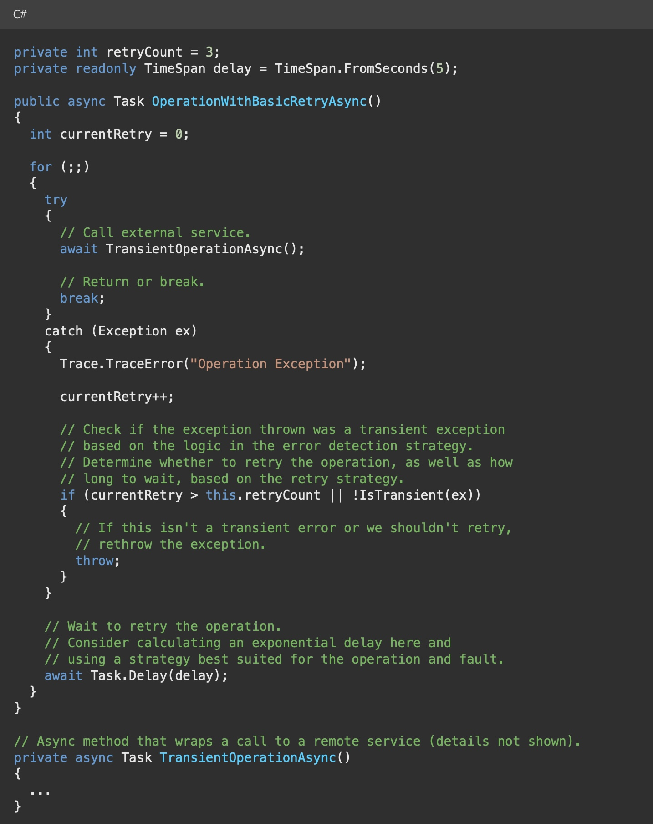
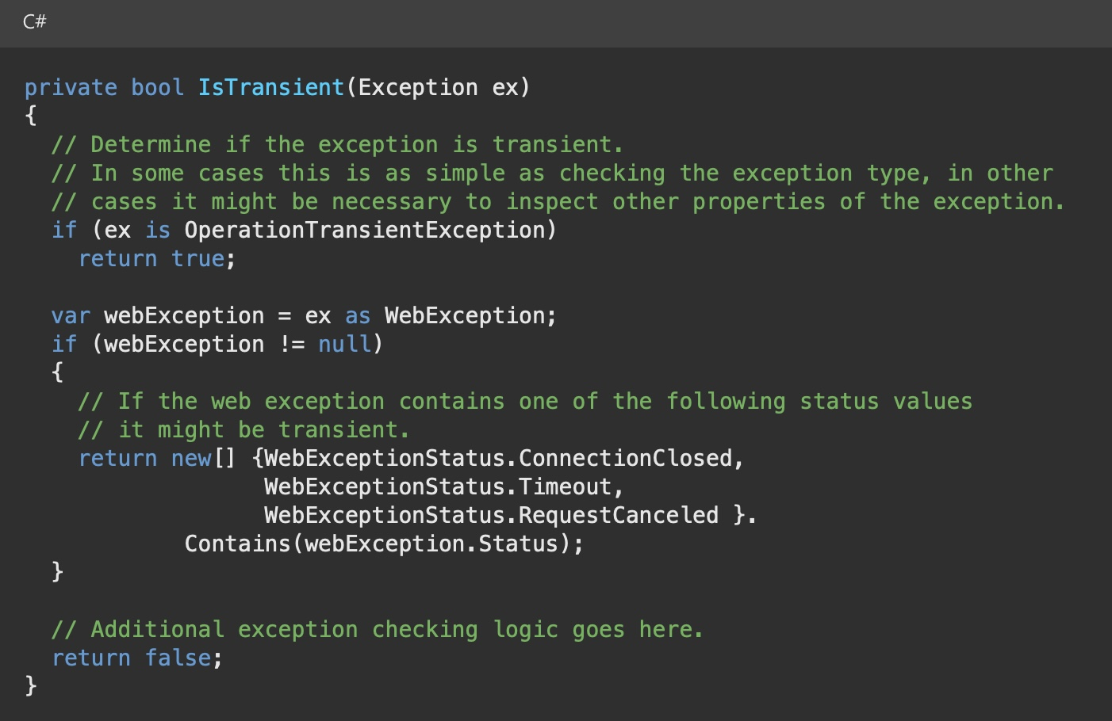

Slide 12
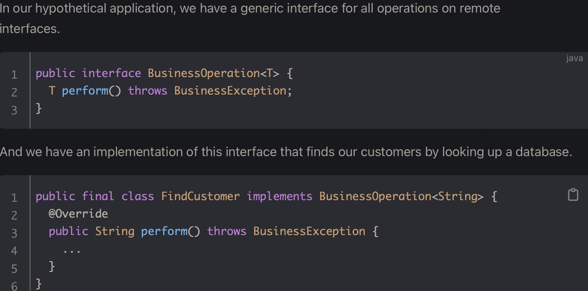
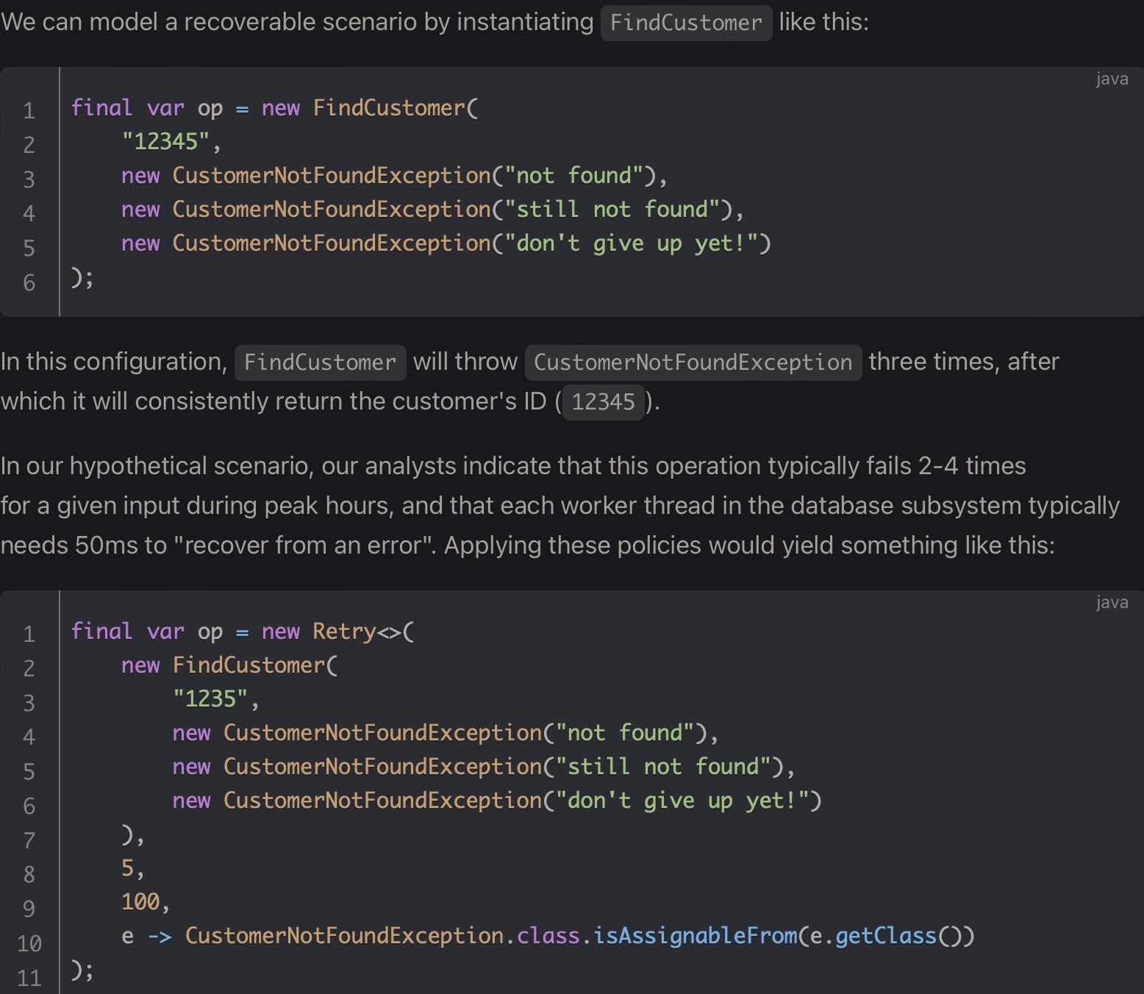
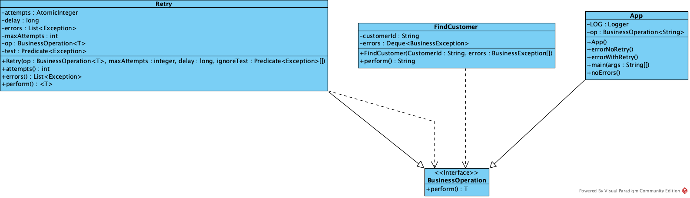

Slide 13
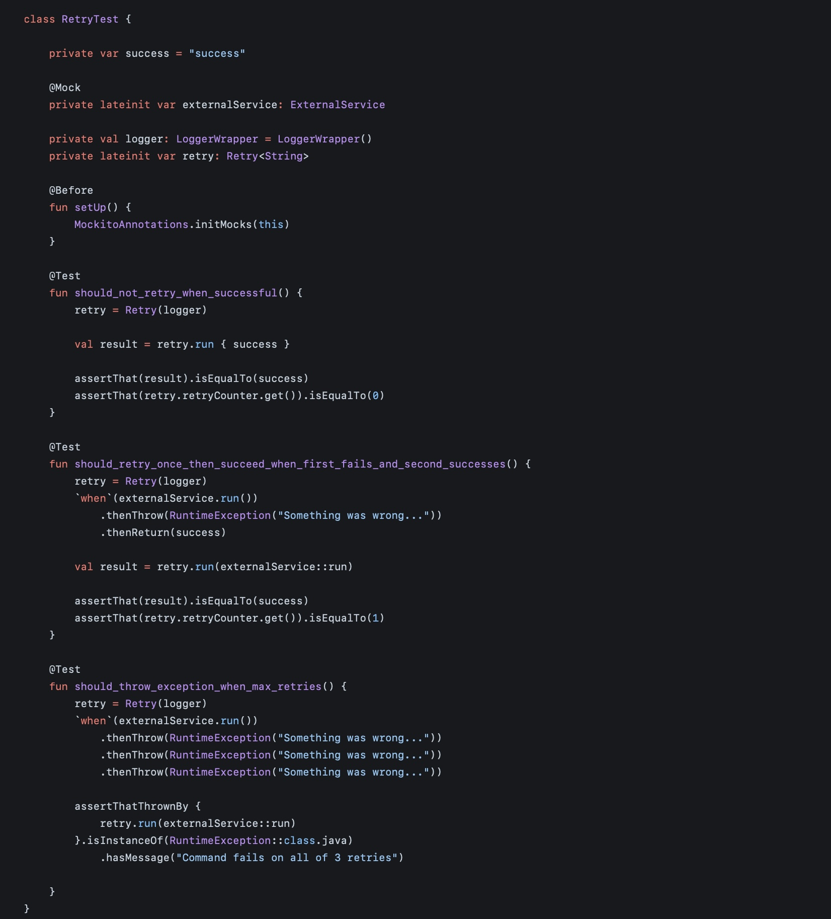
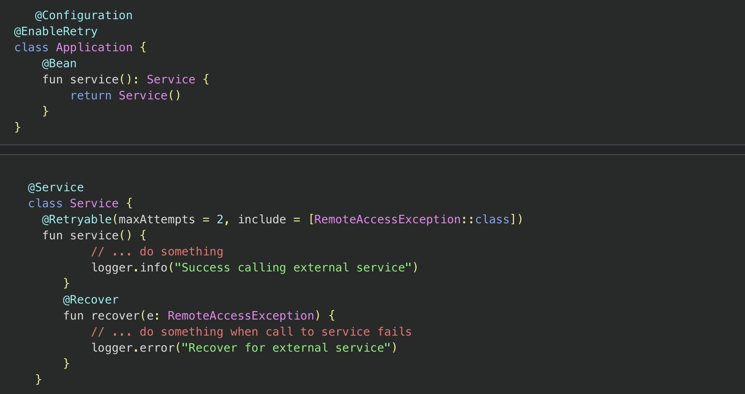
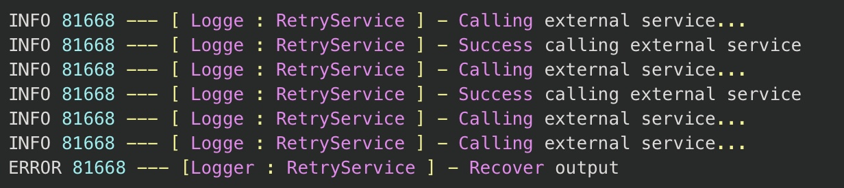

Slide 14
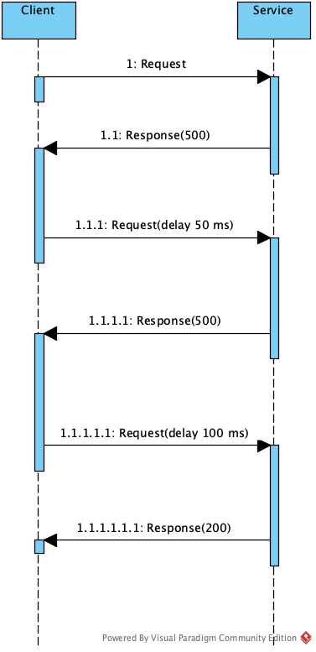
Best practices 🏆
⚠️ Log all connectivity failures
⚠️ Ensure that all retry code is fully tested against a variety of failure conditions
⚠️ Investigate the faults that are most likely to occur
⚠️ Avoid amplifying retries at multiple levels
⚠️ Consider a server-wide retry budget
⚠️ Ensure retries aren’t done on operations where consumers are not waiting for response
⚠️ Never wait synchronously between retry attempts. For example, use “Task.Delay” in place of “Thread.Sleep” in .Net
Notes:
-> benefits of the RP …
Enhanced reliability: the RP significantly contributes to the overall reliability of a system by enabling it to withstand transient failures gracefully. By automatically retrying failed operations, the system can often recover without manual intervention, ensuring a smoother user experience.
Improved user experience: users are more likely to have a positive experience with an application that handles transient failures seamlessly. The RP reduces the impact of intermittent issues, minimising disruptions and enhancing user satisfaction.
Adaptability to dynamic environments: in cloud-based and distributed systems where network conditions and external dependencies can be unpredictable, the RP provides a dynamic and adaptive approach to handling failures. It allows applications to adapt to changing circumstances and maintain functionality in the face of adversity.
->linkedin post/article …
⚠️Log all connectivity failures that cause a retry so that underlying problems with the app, services or resources can be identified.
⚠️Ensure that all retry code is fully tested against a variety of failure conditions. Check that it doesn’t severely impact the performance or reliability of the app, cause excessive load on services and resources or generate bottlenecks.
⚠️Investigate the faults that are most likely to occur for a service or resource and if those faults are long-lasting, it’s better to handle the fault as an exception. The app can report our log the exception and then try to continue either by invoking an alternative service (if one is available) or by offering degraded functionality :c (in which case default data is returned!).
Ensure that retries are not done on operations where consumers are not waiting for response
Try to get value for the “timeout” header from service consumers and if not supplied use the logical default for the operation. While retrying it needs to be checked that the total time of operation do not exceed the timeout specified, as it does not make any sense to retry the operation after consumer has decided that request is failed due to timeout.
Based upon the operation there could be provision to send the cancellation for the operation or way to learn that the consumer is not waiting for response any more (i.e. maybe it has closed the connection). If those signals are available, use them and do not retry.
Consider having a server-wide retry budget
One of the major challenges with retries are that they can cause cascading failures. It is important to slowdown and provide breather to downstream service to recover from failures. Based upon the service, a retry budget can be defined. For example, no more than 50 retries per minute. If the numbers of retries exceeds, then fail the request immediately. The retry budget can be defined at a multiple level, i.e. per minute, every ten minutes, etc.
Use a circuit breaker it the retry budget is exceeded.

Slide 15
Conclusions 🔚
Transient faults with a remote service or resources → do take care of what the error code is before retries
We don't want to be victim of retry anti-patterns
Incorporating intelligent retry logic, exponential backoff and circuit breaker mechanism, developers can create robust systems capable of recovering from unexpected hiccups
As technology continues to evolve, the RP remains a valuable tool of developers
Notes:
The retry pattern stands as a resilient and effective strategy for handling transient failures in SW design. By incoRPorating intelligent retry logic, exponential backoff and circuit breaker mechanism, developers can create robust systems capable of recovering from unexpected hiccups.
As technology continues to evolve, the RP remains a valuable tool in the arsenal of SW architects, contributing to the creation of more reliable and user-friendly applications.
-> medium article … closing remarks
Use the retry pattern when an app could experience transient faults as it interacts with a remote service or accesses a remote resource.
But do take care of what response or error code is returned from downstream services before deciding to retry. Without proper case, you may be victim of retry anti-pattern such as retry amplification, cascading failures, blocking threads and noisy neighbour.
Effective monitoring and logging practices are crucial when utilising the retry pattern to manage transient errors. Key recommendations include logging details of each retry attempt, including timestamps, operation specifics, and associated parameters. Additionally, record the status of each operation, detailing whether it succeeded or failed during each retry. Log backoff strategies, capturing information about the duration of backoffs for analysis. Include comprehensive error details, such as error codes and messages, to aid in diagnosing the cause of transient failures. Utilise unique identifiers for retry instances, particularly in distributed or asynchronous scenarios. Employ different log severity levels to distinguish between informational, warning, and error logs. Aggregate and monitor metrics related to retry patterns, including success rates, average retry numbers, and distribution of backoff durations. Establish alerting mechanisms to notify relevant teams of persistent issues or excessive retries. Log system resource information during retry attempts, such as memory usage and network latency, to identify potential bottlenecks. Consider centralised logging for streamlined analysis and troubleshooting. Regularly review logs to identify patterns or areas for improvement, and document logging policies for consistency and clarity. IncoRPorating these practices enhances insight into retry behaviour, facilitates efficient issue resolution, and promotes continuous system resilience improvement.

Slide 16
References ※📚
Online post:
Author: Vijaya Lakshmi, 2022
Title: Design patterns for micro-services
Website: https://www.linkedin.com/pulse/vijaya-lakshmi-v/
Medium article:
Author: Harish Bhattbhatt, 2021
Title: Best practices for retry pattern
Website: https://harish-bhattbhatt.medium.com/best-practices-for-retry-pattern-f29d47cd5117
Microsoft Article:
Year: 2023
Title: Transient fault handling
Website: https://learn.microsoft.com/en-us/azure/architecture/best-practices/transient-faults
Google Article:
Author: Mike Ulrich, 2017
Title: Addressing Cascading Failures
Website: https://sre.google/sre-book/addressing-cascading-failures/
Microsoft Documentation:
Title: Retry pattern
Website: https://learn.microsoft.com/en-us/azure/architecture/patterns/retry
Journal article:
Author: Kamini Kamal, 2023
Title: Understanding the Retry Pattern
Journal: Medium
Website: https://blog.bitsrc.io/retry-pattern-3f7221913e41?gi=161787a102da
AWS Article:
Author: Marc Brooker, 2015
Title: Addressing Cascading Failures
Website: https://aws.amazon.com/blogs/architecture/exponential-backoff-and-jitter/

Slide 17

🥰

Slide 18

❓🫵🏻❓

